Slide 1
Environment Optimization for Crowd Evacuation
By
Glen Berseth¹, Muhammad Usman², Brandon Haworth², Mubbasir Kapadia³, Petros Faloutsos²
University of British Columbia¹, York University², Rutgers University³
Notes:
Have 30 minutes for talk? 25 minutes for presentation 5 minutes for question.

Slide 2
Crowd Dynamics are Complex
Architects produce functional pieces of art
Want understanding of effect of building changes
Configuration space is infinite
Optimal configuration for crowd dynamics
Crowd dynamics are complex
Designers can’t predict effects of objects
Need computation method for analysis
Notes:
When designing buildings architects produce functional pieces of art that humans and in future robots have to navigate in.
It is difficult to understand the resulting dynamic changes in a crowd due to alterations to environment geometry. A greater understanding of these changes would be of value to the game development, robotics and urban simulation communities.
One reason for the complexity in this understanding is the infinite number of possible configurations in design space for a building
It can be impractical even for experts to construct environments that are optimal for the dynamics of the intended occupants.
Predicting the effect of geometry changes on crowd dynamics is complex given… (numbers, locations, patterns of obstacles), arrangement
Need a computational simulation-based method
We have models that simulate crowd dynamics
Need a framework to simulate a numerically significant number of configurations
To optimize elements in design space

Slide 3

Crowd Behaviour
Notes:
Recent research has found that adding obstacles in crowd simulation can increase crowd flow….

Slide 4
Motivation
Why optimize?
Have: behaviour for environment
Want: environment for behaviour
Simulation construction
Architectural design
Evaluate with ground truth
Crowd dynamics are complex
Perfect steering algorithm
If we had one we could optimize for obstacle placement
Notes:
We have found that we can effect the behaviour of a crowd by adding obstacles
The crowd simulation algorithms give a behaviour for a particular environment
What if we could get the environment for a desired behaviour for the crowd.

Slide 5
Related Work
Crowd Evaluation [Singh et al. 09, Kapadia et al. 11]
Crowd Optimization
Parameters have significant effect [Pettré et al. 12, Pellegrini et al. 09, Davidich and Koester. 11, Wolinski et al. 14]
Optimize to match reference data, objective function [Berseth et al. 14, Wolinski et al. 14]
Game Level Optimization: [Cardamone et al. 11, Sorenson and Pasquier. 10]
Architecture Optimization: [Rodriguez et al. 13]
Notes:
Recent research in crowd analysis and optimization supports this work

Slide 6
Contributions
Framework to analyze configuration space
Study local collision avoidance strategies
Optimize obstacle placement w.r.t. desired behaviour
Could put a system diagram
Notes:
The contribution we make…

Slide 7
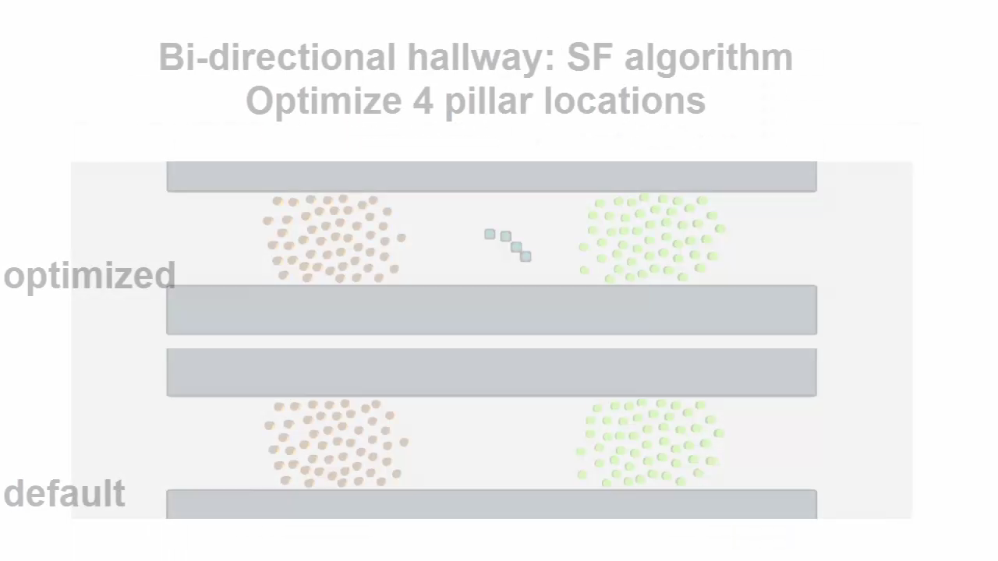
Overview
Framework for analysing and optimizing crowd flow
Three representative steering algorithms
time
Notes:
A brief overview of the work

Slide 8
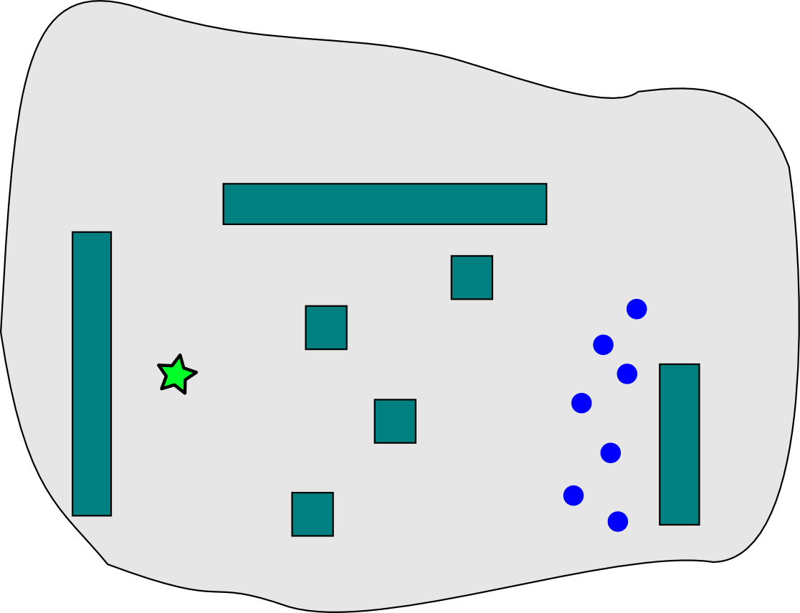
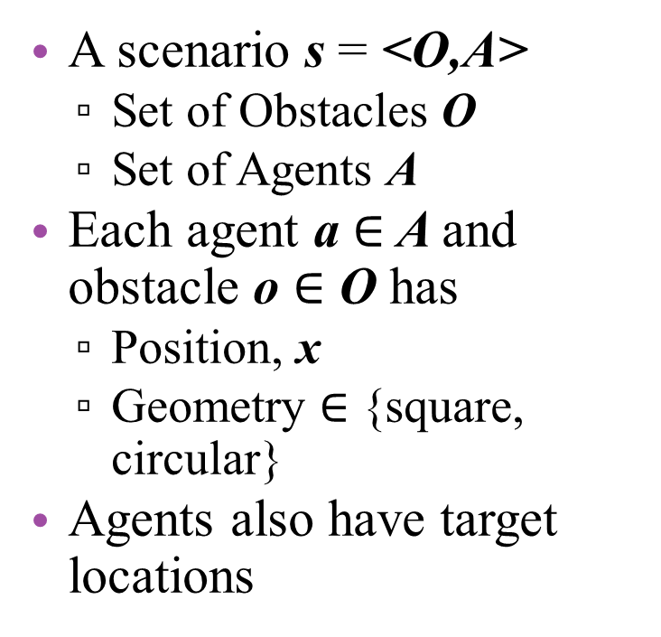
A Scenario
A scenario s = <O,A>
Set of Obstacles O
Set of Agents A
Each agent a $∈$ A and obstacle o $∈$ O has
Position, x
Geometry $∈$ {square, circular}
Agents also have target locations
Notes:
We start by defining a Scenario

Slide 9
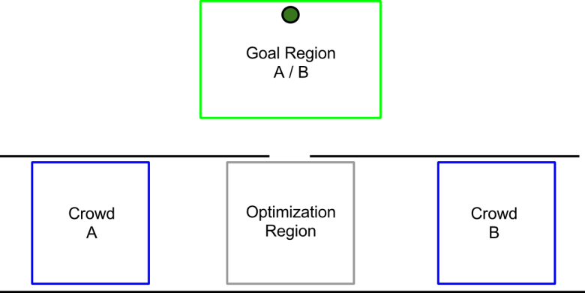
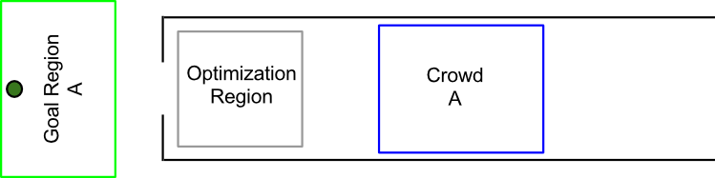
Parameterized Scenario
Define subspace of scenarios
Agent regions
Bounding area to place number of agents (blue box)
Locations can be randomly sampled
Collective target location (Green circle)
Optimization regions
Bounding region where obstacles can be located (grey box)
Scenario parameters p
Determine number and location of obstacles
Notes:
Next, we construct a parameterized scenario this is a looser definition of a scenario. That we call a scenario subspace

Slide 10
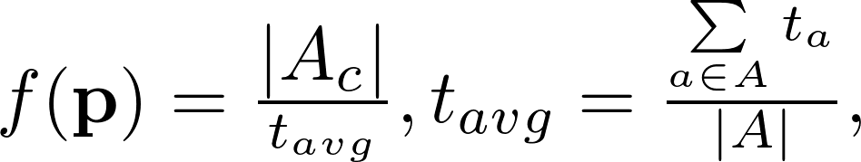
Crowd Flow
t_{a}, the completion time for agent a
|A|, number of agents in scenario
|Ac|, number of agents that complete scenario
Notes:
The behaviour we are interested in studying is crowd flow

Slide 11
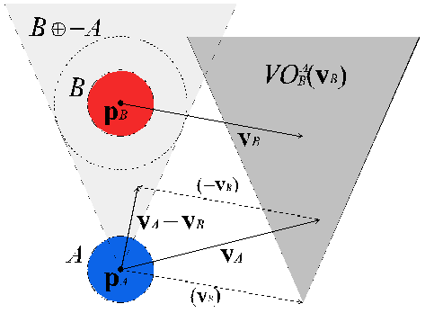
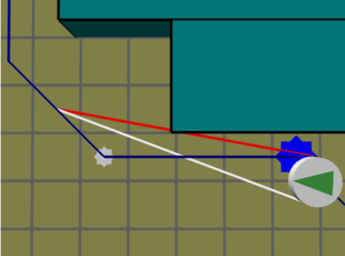
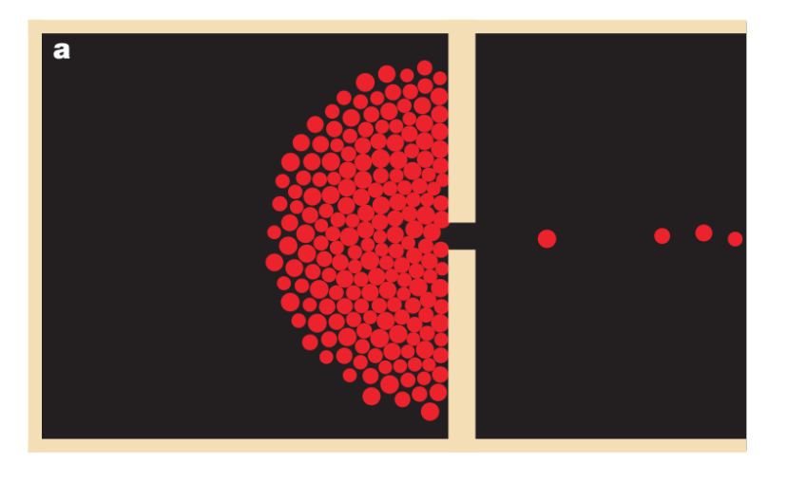

Steering Algorithms
ORCA [van den Berg et al. 11]
PPR [Singh et al. 09]
Social Forces [Helbing et al. 2000]
Notes:
We use 3 steering algorithms, chosen because they are very representative of the different steering models.

Slide 12
One-way Hallway Benchmark
Example Subspace
Randomly sampled crowd
Goal Region for crowd A
Avoids congestion
Region to optimize obstacle placement
Notes:
Regions are important, don’t use goal location

Slide 13
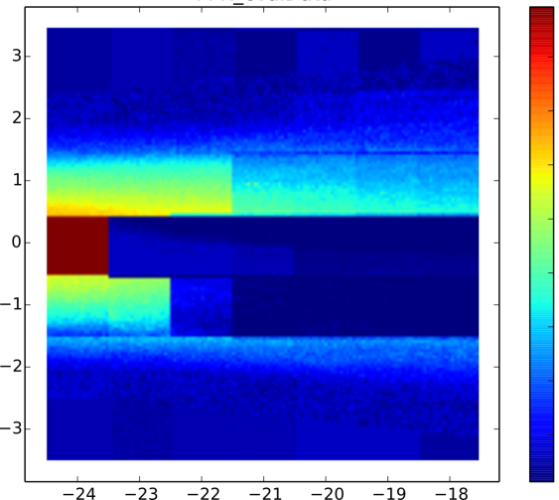
Path Planning Issues
Uniform Sampling of Optimization Region
low
high
Blue is better
Grid-based planning
Discontinuities
Crowd Congestion
Dilute effects of steering strategy
Don’t use planning
Notes:
The first thing you might think of to do is a uniform, brute force sampling of the optimization region, for a single obstacle…
We found that global navigation was causing issue in crowd flow behaviour
Explain the graph in the middle

Slide 14
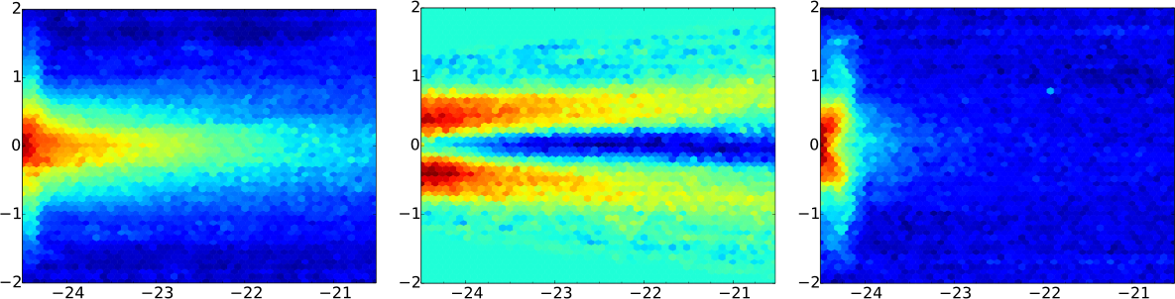
Uniform Sampling of Optimization Region
ORCA
PPR
SF
Significant difference between algorithms
Obstacle geometry
ORCA preferred square; SF, circular
Notes:
After we stop using global navigation methods we get a nice smooth crowd flow behaviour with respect to the location of a singe obstacle
Single Obstacle
Sampled at 2.5cm
Repulsive forces between sf agents and ROUND obstacles are smoother

Slide 15
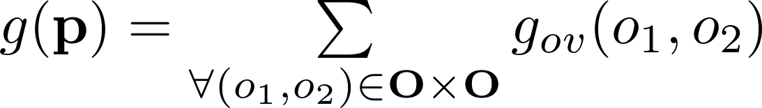
Obstacle Optimization
Optimize for multiple obstacles
Need obstacle overlap penalty
Objective
Non-convex function
Notes:
Now that we have a smooth function for crowd flow…

Slide 16
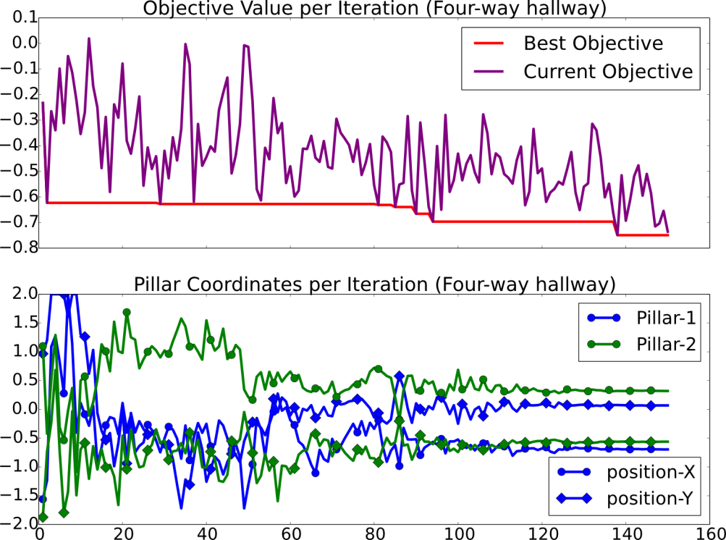
CMA-ES optimization
Competitive convergence speed
Easy to implement and use
Handles noise
Works well with non-convex functions
Competitive convergence speed
Easy to implement and use
Example optimization
Notes:
To handle non-convex optimization…
Move picture

Slide 17
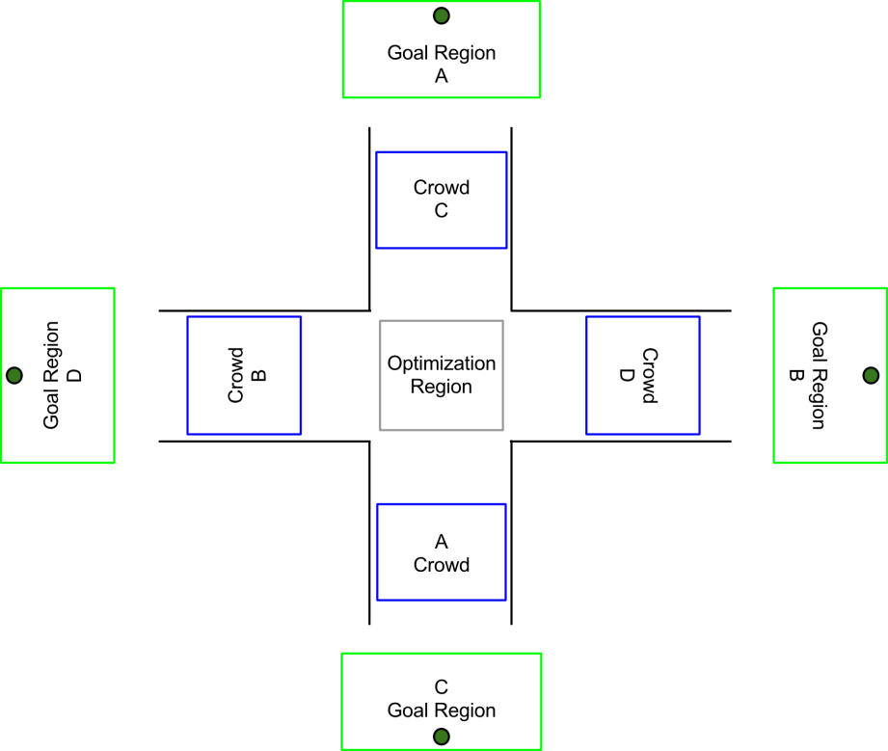
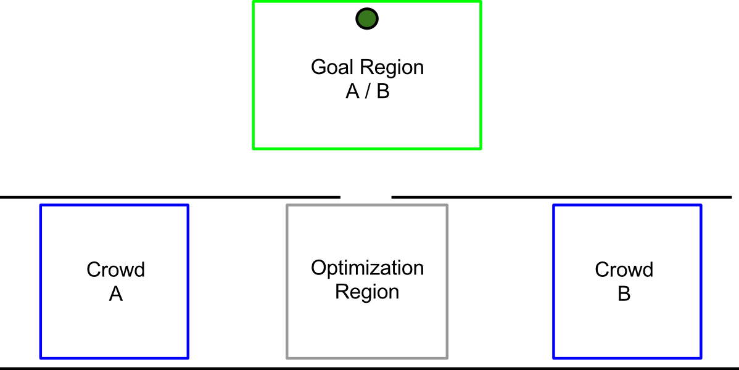
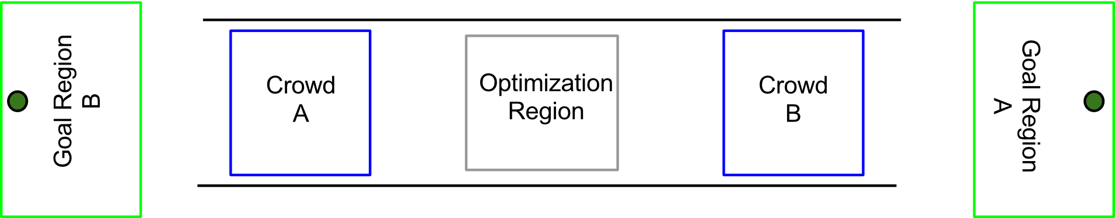
More Benchmarks
Four-way Hallway
Two-way Egress
Bi-directional Hallway
Notes:
I’ll briefly descried the other benchmarks we used…

Slide 18
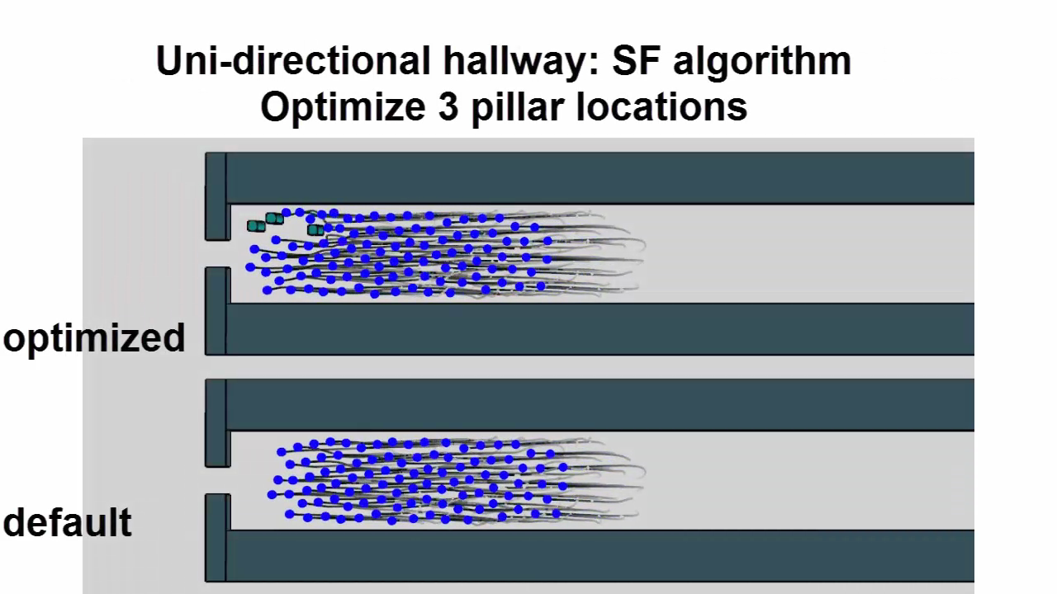
Uni-directional Hallway
2.19
1.92

Slide 19
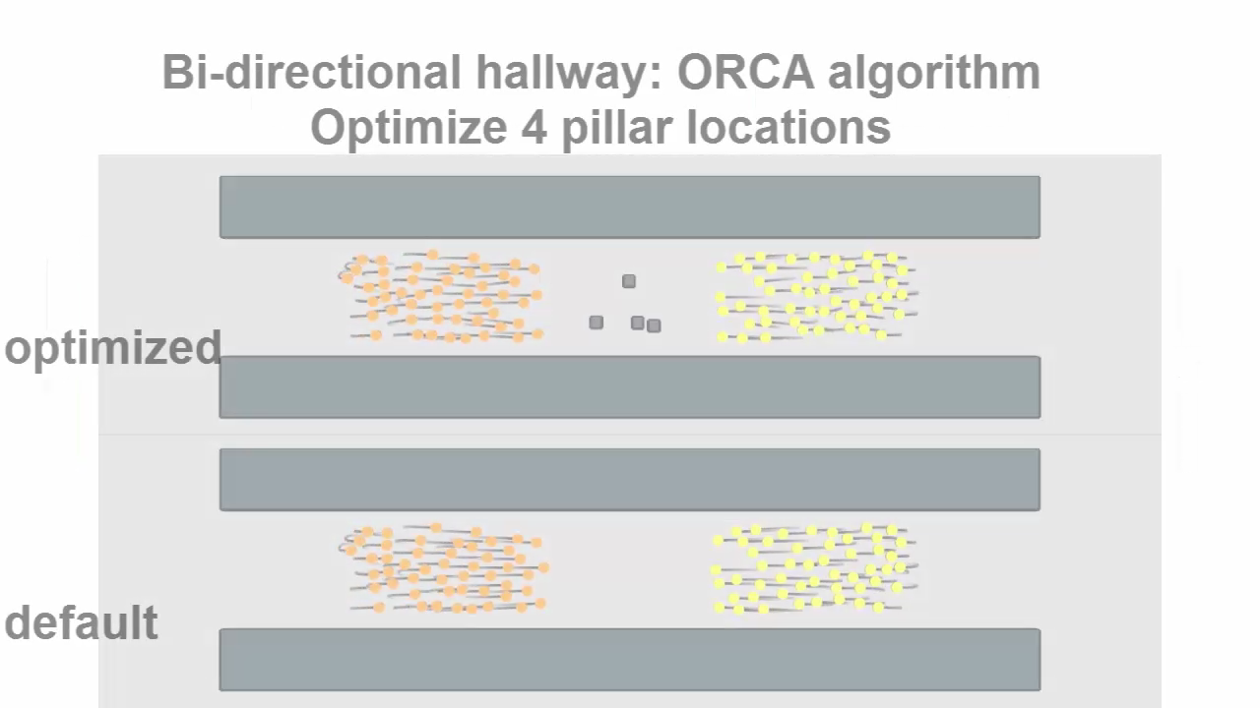
Bi-directional Hallway
Flow: 3.63
Flow: 2.84
Notes:
Form lanes of traffic

Slide 20
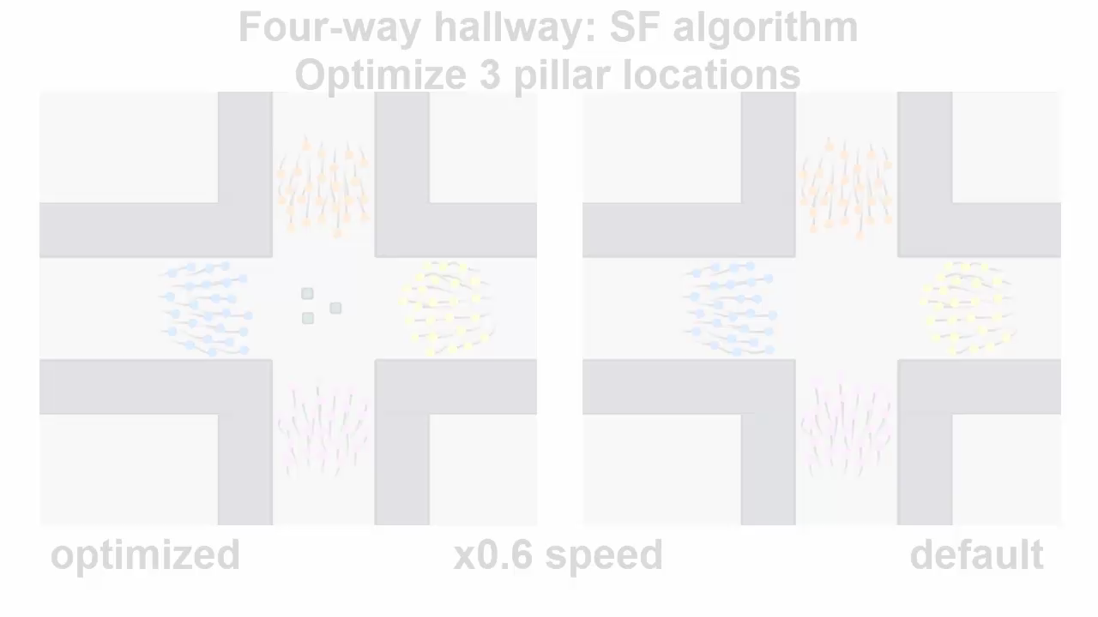
Four-way Hallway
Flow: 3.93
Flow: 3.48
Notes:
Circular behaviour in the crowd

Slide 21
Discussion
Overall the optimal number of pillars is 3
Optimization convergence:
Fastest for Uni-directional
Slowest for Egress
Adding pillars increases flow
Pillar arrangement
Placed in parallel with crowd flow (Uni or Bi)
Triangular pattern in Egress and Four-way
Notes:
After optimizing on a collection of benchmarks over a set of crowd simulation algorithms…

Slide 22
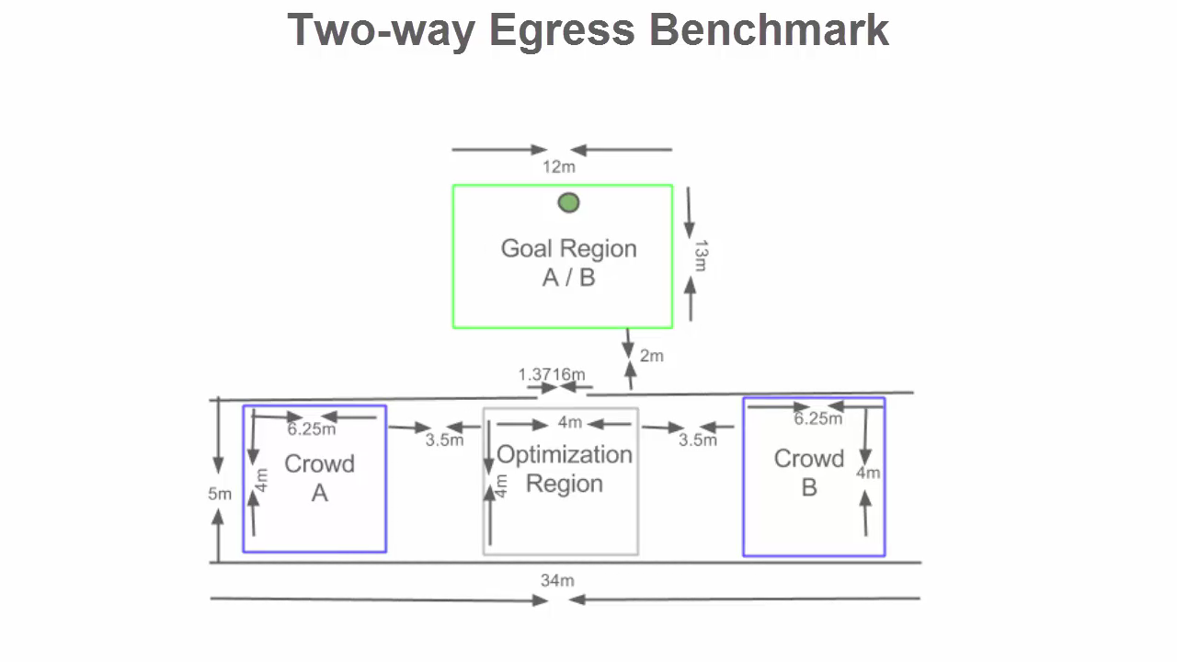
Doorway width analysis
Notes:
We are also interested in studying the effect of doorway with on the behaviour of the crowd and the optimal locations of pillars.
Play the video

Slide 23
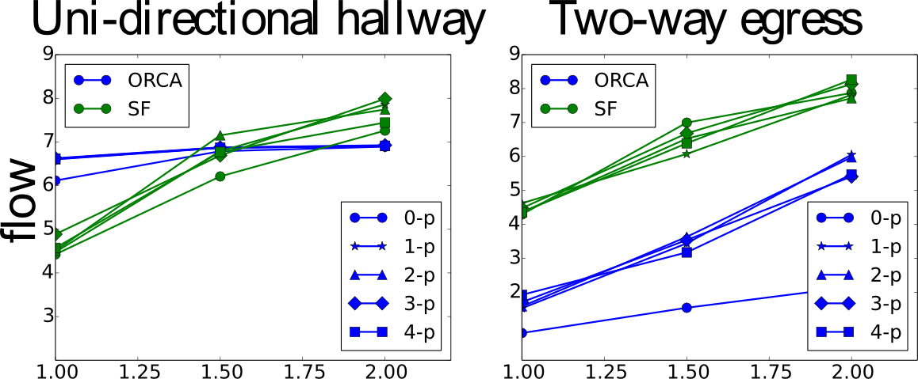
Doorway width Analysis
Related to flow
Large increase for Egress
More important for perpendicular crowd flow
Flow dependant on door arrangement
Doorway width
Notes:
We find that..
Doorway width is related to flow
Increasing….
Significant improvement for Egress benchmark
These results show that flow is dependant on doorway arrangement
We find it is more important to increase door width for perpendicular crowd flow

Slide 24
Review
Obstacle number and placement important
Doorway width is important
Limitations:
Optimal obstacle placement different for algorithms
Need for community to establish real algorithm
Future work
More steering algorithms
Global Navigation
Notes:
Obstacle number and placement significant
Doorway width
Optimal placement can be dependant on steering algorithm
Need a perfectly human algorithm
Expand work to more steering algorithms

Slide 25
Questions?
Environment Optimization for
Crowd Evacuation
By
Glen Berseth¹, Muhammad Usman², Brandon Haworth², Mubbasir Kapadia³, Petros Faloutsos²
University of British Columbia¹, York University², Rutgers University³

